Slide 1


COMM 293
FINAL REVIEW SESSION
by Suprabhe Ballary

Slide 2


Property, Plant and Equipment
1) Tangible Asset: physical substance Examples – PPE 2) Intangible Asset: lacks physical substance copyright, patent, trademarks, goodwill
Key concepts:
- Useful life: the economic life of an asset determined to allocate the benefit derived from the asset - Salvage value: the remaining value at which the asset can be sold at the end of useful period - Depreciation/Amortization: a reduction in the value of an asset with the passage of time (not a measure of decline in economic value) - Accumulated depreciation: contra asset account - Historical cost principle: the assets are recorded at acquisition cost initially Important question: which type of costs are included in the acquisition cost? The costs which make the asset functional to use. Examples – testing, installation, transportations, labour, material cost
facebook.com/ubccmp
twitter.com/ubccmp
@ubccmp
cmp.cus.ca

Slide 3
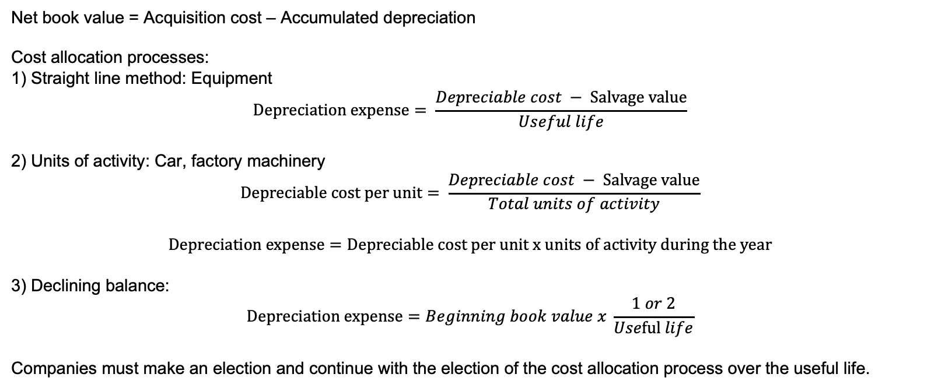
Property, Plant and Equipment
Net book value = Acquisition cost – Accumulated depreciation Cost allocation processes: 1) Straight line method: Equipment $$Depreciation expense= \frac{Depreciable cost − Salvage value}{Useful life}$$ 2) Units of activity: Car, factory machinery $$Depreciable cost per unit= \frac{Depreciable cost − Salvage value}{Total units of activity}$$ $$Depreciation expense=Depreciable cost per unit x units of activity during the year$$ 3) Declining balance: $$Depreciation expense=Beginning book value x \frac{1 or 2}{Useful life}$$ Companies must make an election and continue with the election of the cost allocation process over the useful life.
facebook.com/ubccmp
twitter.com/ubccmp
@ubccmp
cmp.cus.ca

Slide 4



Property, Plant and Equipment
1) Straight line method: Equipment $$Depreciation expense= \frac{Depreciable cost − Salvage value}{Useful life}$$
PRACTICE: Company A purchases a machine. The purchase price of $120,000 included testing for $45,000, insurance of $5,000, installation fees of $50,000 and training cost of $20,000. The estimated salvage value of $20,000 and a useful life of 5 years. A) What is the depreciable cost? B) Calculate the depreciation expense for year 1. C) Provide the journal entry for year 2. D) What is the net book value at the end of year 3?
facebook.com/ubccmp
twitter.com/ubccmp
@ubccmp
cmp.cus.ca

Slide 5
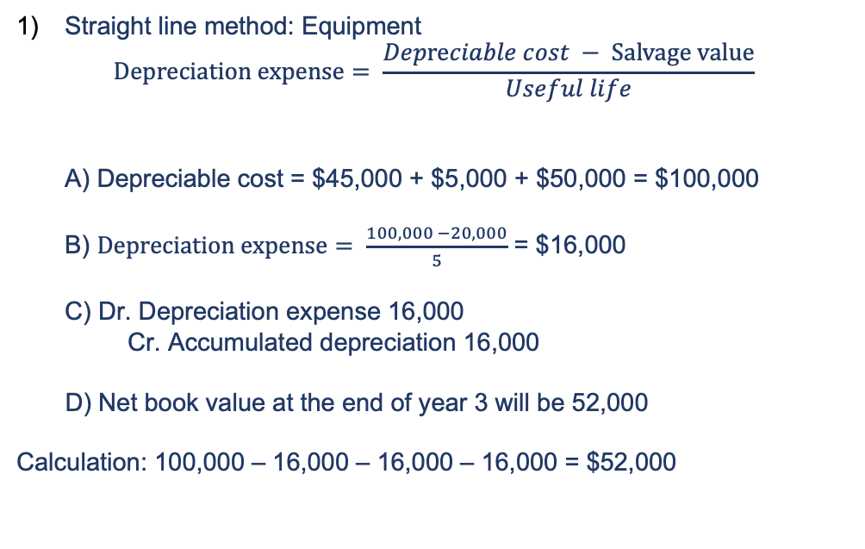
Property, Plant and Equipment
Straight line method: Equipment $Depreciation expense= \frac{Depreciable cost − Salvage value}{Useful life}$ A) Depreciable cost = $45,000 + $5,000 + $50,000 = $100,000 B) $Depreciation expense= \frac{100,000 −20,000}{5}$ = $16,000 C) Dr. Depreciation expense 16,000
Cr. Accumulated depreciation 16,000
D) Net book value at the end of year 3 will be 52,000 Calculation: 100,000 – 16,000 – 16,000 – 16,000 = $52,000
PRACTICE: Company A purchases an Equipment. The purchase price of $120,000 included testing for $45,000, insurance of $5,000, installation fees of $50,000 and training cost of $20,000. The estimated salvage value of $20,000 and a useful life of 5 years. A) What is the depreciable cost? B) Calculate the depreciation expense for year 1. C) Provide the journal entry for year 2. D) What is the net book value at the end of year 3?
facebook.com/ubccmp
twitter.com/ubccmp
@ubccmp
cmp.cus.ca

Slide 6


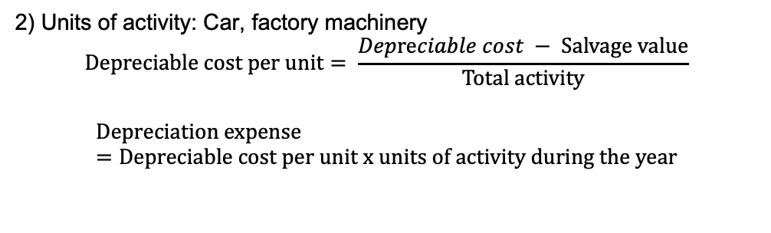
Property, Plant and Equipment
2) Units of activity: Car, factory machinery $$Depreciable cost per unit= \frac{Depreciable cost − Salvage value}{Total activity}$$ $$Depreciation expense=Depreciable cost per unit x units of activity during the year$$
PRACTICE: Company B uses truck for delivering flowers. The purchase price of the truck was $100,000. The estimated salvage value of $20,000. The capacity of the truck is 100,000 miles. In year 2, company B used 15,000 miles. In year 1, the depreciation expense was $10,000. A) What is the depreciable cost per unit? B) Calculate the depreciation expense for year 2. C) Provide the journal entry for year 2.
D) Net book value at end of year 2?
facebook.com/ubccmp
twitter.com/ubccmp
@ubccmp
cmp.cus.ca

Slide 7
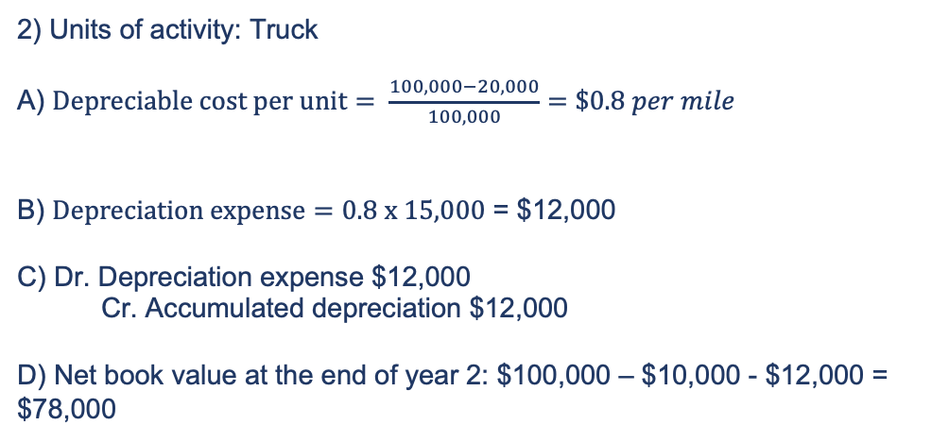
Property, Plant and Equipment
2) Units of activity: Truck A) $Depreciable cost per unit= \frac{100,000−20,000}{100,000}=\$0.8 per mile$ B) $Depreciation expense=0.8 x 15,000$ = $12,000 C) Dr. Depreciation expense $12,000 Cr. Accumulated depreciation $12,000 D) Net book value at the end of year 2: $100,000 – $10,000 - $12,000 = $78,000
PRACTICE: Company B uses truck for delivering flowers. The purchase price of the truck was $100,000. The estimated salvage value of $20,000. The capacity of the truck is 100,000 miles. In year 2, company B used 15,000 miles. In year 1, the depreciation expense was $10,000. A) What is the depreciable cost per unit? B) Calculate the depreciation expense for year 2. C) Provide the journal entry for year 2. D) What is the book value at the end of year 2?
facebook.com/ubccmp
twitter.com/ubccmp
@ubccmp
cmp.cus.ca

Slide 8


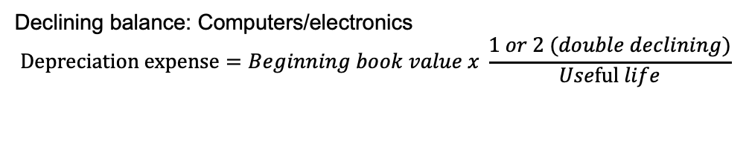
Property, Plant and Equipment
Declining balance: Computers/electronics $$Depreciation expense=Beginning book value x \frac{1 or 2 (double declining)}{Useful life}$$
PRACTICE: Company C uses a computer. The purchase price of the computer was $100,000. The useful life is 5 years. The estimated salvage value of $20,000. Use declining balance. A) What is the depreciable expense in year 1? B) What is the depreciable expense for year 2? C) What is the depreciable expense in year 1 if it was double declining balance?
facebook.com/ubccmp
twitter.com/ubccmp
@ubccmp
cmp.cus.ca

Slide 9
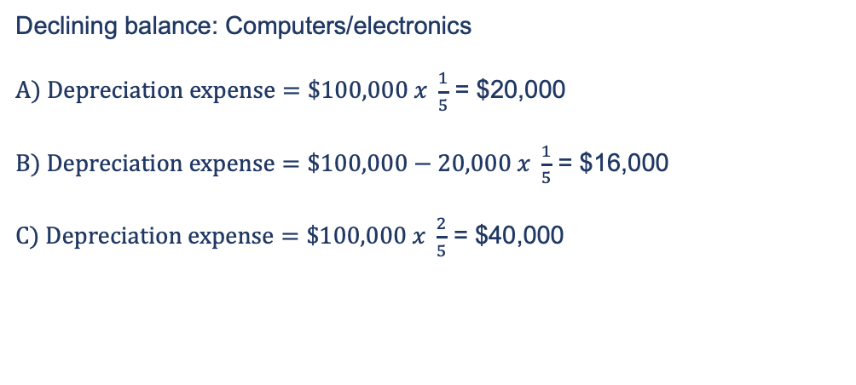
Property, Plant and Equipment
PRACTICE: Company C uses a computer. The purchase price of the computer was $100,000. The useful life is 5 years. The estimated salvage value of $20,000. A) What is the depreciable expense in year 1? B) What is the depreciable expense for year 2? C) What is the depreciable expense in year 1 if it was double declining balance?
Declining balance: Computers/electronics $A) Depreciation expense=\$100,000 x \frac{1}{5}$ = $20,000 $B) Depreciation expense=\$100,000−20,000 x \frac{1}{5}$ = $16,000 $C) Depreciation expense=\$100,000 x \frac{2}{5}$ = $40,000
facebook.com/ubccmp
twitter.com/ubccmp
@ubccmp
cmp.cus.ca

Slide 10
Property, Plant and Equipment
Transaction | Journal entry
Acquisition/Purchase of asset | Dr. Asset Cr. Cash/AP
Expenditure | Dr. Repair/maintenance expense Cr. Cash/AP
Impairment | Dr. Loss Cr. Asset
Disposal (gain) – Proceeds > NBV | Dr. Cash Dr. Accumulated depreciation Cr. Gain on disposal Cr. Asset
Disposal (loss) – Proceeds < NBV | Dr. Loss on asset Dr. Accumulated depreciation Dr. Cash Cr. Asset
Retirement (no sale) | Dr. Accumulated depreciation Cr. Asset
Retirement if salvage value is not received | Dr. Accumulated depreciation Dr. Loss on disposal of asset Cr. Asset
SUBSEQUENT MEASUREMENT: Impairment: this occurs when the carrying value or net book value/carrying value is less than the recoverable amount Recoverable amount is the higher of 1) Fair value – selling costs OR 2) Value in use: PV of future cash flows from the use of the asset Derecognition: Derecognizing an asset means that it has been sold or damaged or retired at the end of useful life. In which case, any accounting gain/loss should be calculated.
facebook.com/ubccmp
twitter.com/ubccmp
@ubccmp
cmp.cus.ca

Slide 11
Property, Plant and Equipment
PRACTICE: Company D sells its equipment for $20,000 in cash. The original price of the equipment was $50,000. As of January 2020, it has an accumulated depreciation of $40,000. Depreciation for the first 6 months is $5000. A) Journal entry for recording depreciation expense. B) Calculate gain/loss on disposal. C) Provide journal entry to record the gain.
facebook.com/ubccmp
twitter.com/ubccmp
@ubccmp
cmp.cus.ca

Slide 12
Property, Plant and Equipment
PRACTICE: Company D sells its equipment for $20,000 in cash. The original price of the equipment was $50,000. As of January 2020, it has an accumulated depreciation of $40,000. Depreciation for the first 6 months is $5000. Provide: A) Journal entry for recording depreciation expense. B) Calculate gain/loss on disposal. C) Provide journal entry to record the gain.
A) Dr. Depreciation expense $5,000 Cr. Depreciation expense $5,000 B) Gain on sale would be as follows: Cost (50,000) - Accumulated depreciation (40,000 + 5,000) = Net book value Net book value at disposal = 5,000 Proceeds = 20,000 Gain = $15,000 (20,000 – 5,000) C) Dr. Cash 20,000 Dr. Accumulated depreciation $45,000 Cr. Equipment $50,000 Cr. Gain on sale $15,000
facebook.com/ubccmp
twitter.com/ubccmp
@ubccmp
cmp.cus.ca

Slide 13
Natural resources
Initial recognition: Exploration and development Subsequent measurement: Depletion (usually the use of units of activity method) of coal mine Formula: Unit depletion rate: (Total cost-residual value)/estimated total extractable units Depletion cost: unit depletion rate x number of units extracted Depletion cost is capitalized as inventory: Dr. Inventory Cr. Accumulated depletion
facebook.com/ubccmp
twitter.com/ubccmp
@ubccmp
cmp.cus.ca

Slide 14
Research and development
IFRS | GAAP
Research phase must be expensed | Research phase must be expense
Development phase CAN be capitalized | Development phase must be expensed
Intangibles Definite lives: patents, copyrights Indefinite lives: goodwill, trademark, licenses, franchises Goodwill (when there is an acquisition): Purchase price – fair value of net identifiable assets
facebook.com/ubccmp
twitter.com/ubccmp
@ubccmp
cmp.cus.ca

Slide 15
Liabilities
Current liabilities: obligations to a third party to be paid within a year Example: Accounts Payable, overdrafts/loans Initial: Dr. Asset/expense Cr. A/P
Non-current liabilities: obligations to a third party to be paid after a year Example: Bonds
Subsequent: Dr. A/P Cr. Cash
Initial: Dr. Cash Cr. Note payable
Interest incurred: Dr. interest expense Cr. Interest payable
At maturity: Dr. Note payable Dr. Interest payable Cr. Cash
Provision liabilities Dr. Warranty expense Cr. Provision for warranties Once incurred: Dr. Provision for warranties Cr. Cash
facebook.com/ubccmp
twitter.com/ubccmp
@ubccmp
cmp.cus.ca

Slide 16
Liabilities
Sales Tax: Dr. Cash Cr. Sales revenue Cr. Sales tax payable
Payroll (Initial) Dr. Salary expense Cr. Income tax payable Cr. CPP payable Cr. EI payable Cr. Salaries payable
Payroll (paid to employees) Dr. Salaries payable Cr. Cash
Payroll (Initial) Dr. Compensation expense Cr. CPP Payable Cr. EI payable
Payroll (paid to government) Dr. CPP payable Dr. EI payable Dr. Income tax payable Cr. Cash
Unearned revenue Dr. Cash Cr. Unearned revenue
Unearned revenue (when earned) Dr. Unearned revenue Cr. Revenue
facebook.com/ubccmp
twitter.com/ubccmp
@ubccmp
cmp.cus.ca

Slide 17
Liabilities
PRACTICE: 1) Fancy bank agrees to lend $100,000 to Company A on September 1, 2020. The terms of the loan are that that the interest rate will be 10% and the loan matures in 4 months. The note matures on January 1. Provide journal entries on: A) September 1st
B) December 31st C) Jan 1, 2021 2) Amazon sells 50 iphone 12 pro max September 2 costing $1600 each. However, the phones will reach the customers after 2 days as per 2 days shipping for amazon prime members. Provide journal entries for: A) Initial sale B) Once the phones have been delivered on September 4.
facebook.com/ubccmp
twitter.com/ubccmp
@ubccmp
cmp.cus.ca

Slide 18
Liabilities
PRACTICE: 1) A) Dr. Cash $100,000 Cr. Note payable. $100,000
1) B) Interest = 10% x $100,000 x 4/12 = $3,333 Dr. Interest expense $3,333 Cr. Interest Payable $3,333 1) C) Dr. Notes payable $100,000 Dr. Interest payable $3,333 Cr. Cash $103,333
PRACTICE: 1) Fancy bank agrees to lend $100,000 to Company A on September 1, 2020. The terms of the loan are that that the interest rate will be 10% and the loan matures in 4 months. The note matures on January 1. Provide journal entries on: A) September 1st
B) December 31st C) Jan 1, 2021 2) Amazon sells 50 iPhone 12 pro max September 2 costing $1800 each. However, the phones will reach the customers after 2 days as per 2 days shipping for amazon prime members. Provide journal entries for: A) Initial sale B) Once the phones have been delivered on September 4.
PRACTICE: 2) A) Dr. Cash $90,000 Cr. Unearned revenue $90,000 2) B) Dr. Unearned revenue 90,000 Cr. Revenue $90,000
facebook.com/ubccmp
twitter.com/ubccmp
@ubccmp
cmp.cus.ca

Slide 19
Bonds
Why so much complication? Timing difference between agreement and arrangement of contract. Bonds are traded on the stock market. What is PV of principal + interest payments? = proceeds Coupon rate < market rate = Discount bond in which case the price < face value Coupon rate > market rate = Premium bond in which case the price > face value Effective interest rate method Interest payments (paid) = Face value * coupon rate Interest expense = beginning carrying value * market rate Amortization of discount increases carrying value Amortization of premiums decreases carrying value
Journal entries (discount) Issuance: Dr. Cash Dr. Discount on B/P Cr. Bonds payable Interest: Dr. Interest expense Cr. Interest payable Cr. Discount on B/P
Journal entries (premium) Issuance: Dr. Cash Cr. Premium on B/P Cr. Bonds payable Interest: Dr. Interest expense Dr. Premium on B/P Cr. Bonds payable
Gain/Loss on bond: Dr. Bonds payable Cr. Cash (Cr. Gain on bond redemption) (Dr. Loss on bond redemption)
facebook.com/ubccmp
twitter.com/ubccmp
@ubccmp
cmp.cus.ca

Slide 20
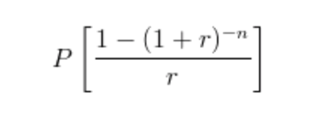
Bonds
PRACTICE: A) DISCOUNT: Amazon issues a 3-year bonds with face value of $1,000,000 at the coupon rate of 6% semiannually on 1st Jan 2020. The market rate is 8%. 1) Initial journal entry
2) Record the interest expense on 1st January 2022 3) Record the interest expense on July 1st 2021. B) PREMIUM: Amazon issues a 3-year bonds with face value of $1,000,000 at the coupon rate of 9% on 1st Jan 2020. The market rate is 7%. 1) Initial journal entry
2) Record the interest expense on 1st January 2021
Present value of all interest payments which will be received: P = Interest payments (actually paid per coupon) r = market rate n = number of periods
facebook.com/ubccmp
twitter.com/ubccmp
@ubccmp
cmp.cus.ca

Slide 21
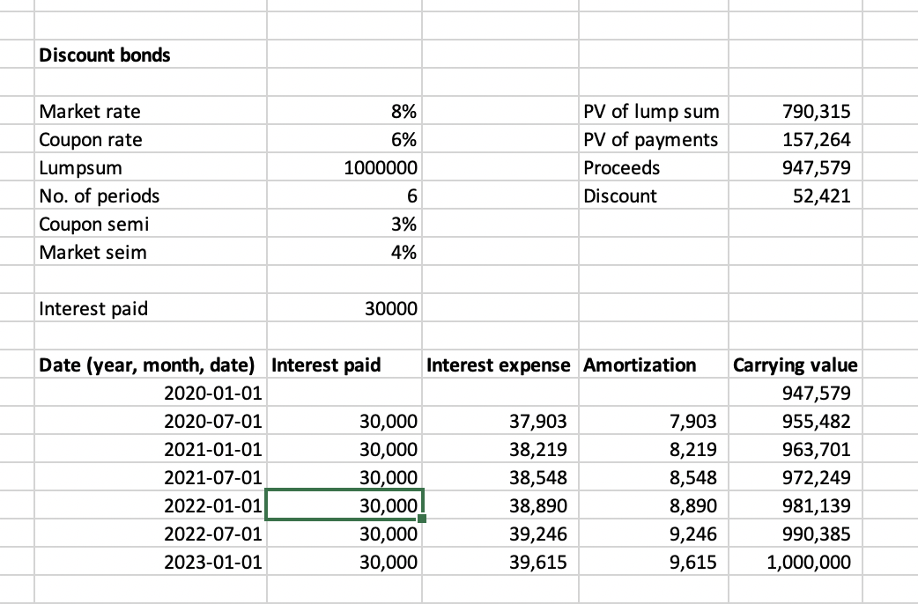
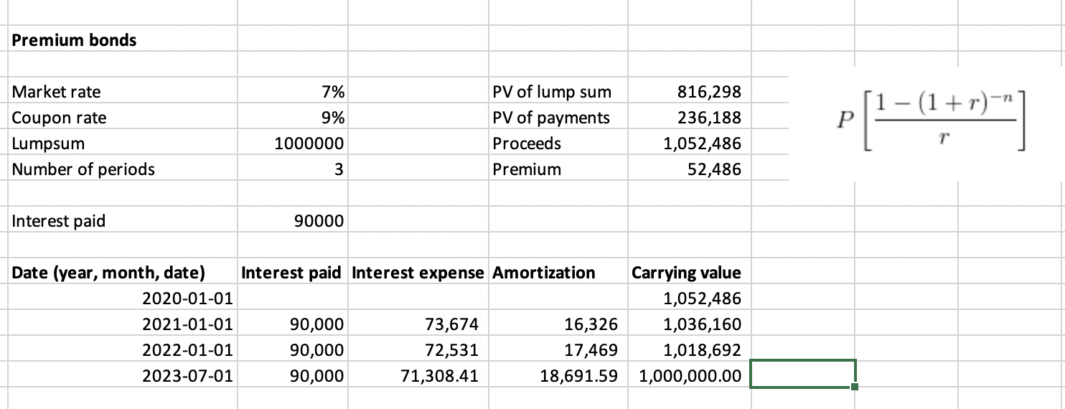
Bonds
facebook.com/ubccmp
twitter.com/ubccmp
@ubccmp
cmp.cus.ca

Slide 22
Bonds
PRACTICE: A) DISCOUNT: Amazon issues a 3-year bonds with face value of $1,000,000 at the coupon rate of 6% semiannually on 1st Jan 2020. The market rate is 8%. 1) Initial journal entry (at issuance) Dr. Cash 947,579 Dr. Discount on bond 52,421 Cr. Bonds payable 1,000,000
2) Dr. Interest expense 38,890 Cr. Cash 30,000 Cr. Amortization of bond discount 8,890 3) Dr. Interest expense 38,548 Cr. Cash 30,000 Cr. Amortization of bond discount 8,548
PRACTICE: A) B) PREMIUM: Amazon issues a 3-year bonds with face value of $1,000,000 at the coupon rate of 9% on 1st Jan 2020. The market rate is 7%. 1) Initial journal entry (at issuance) Dr. Cash 1,052,486 Cr. Premium on bond 52,486 Cr. Bonds payable 1,000,000
2) Dr. Interest expense 73,674 Dr. Premium on bond/payable 16326 Cr. Cash $90,000
facebook.com/ubccmp
twitter.com/ubccmp
@ubccmp
cmp.cus.ca

Slide 23
Shareholder’s equity
Reacquisition of shares When purchase price = average price Dr. Common shares Cr. Cash When purchase price < average price Dr. Common shares Cr. Cash Cr. Contributed surplus When purchase price > average price Dr. Common shares Dr. Contributed surplus Cr. Cash
Declaration of Cash dividends Dr. Dividends declared Cr. Dividends payable Declaration of stock dividends Dr. Stock dividends (-SE) Cr. Common stock dividends payable (+SE) Payment: Dr. Dividends payable Cr. Cash Dr. Common stock dividends payable Cr. Common shares
Issuance of shares: Dr. Cash Cr. Common shares or could be Dr. Asset/expense Cr. Common shares
Important: When there is a loss, the loss should be deducted from contributed surplus until the account balance becomes 0. If there is excess loss, then it is deducted from the retained earnings.
facebook.com/ubccmp
twitter.com/ubccmp
@ubccmp
cmp.cus.ca

Slide 24
Shareholder’s equity
PRACTICE: Patrick’s spa declared and paid dividends of $2,000 on October 1st 2016.
 | 2016 | 2015
Common shares ($) | 120,000 | 100,000
RE ($) | 80,000 | 50,000
Shareholder’s equity ($) | 200,000 | 150,000
A) If Patrick’s spa sold 20,000 shares on July 1st 2016, what is the average selling price of shares? Assume that that was the only transaction in the year. B) Provide Journal entry for the sale of shares C) What is the net income in 2018?
facebook.com/ubccmp
twitter.com/ubccmp
@ubccmp
cmp.cus.ca

Slide 25
Shareholder’s equity
PRACTICE: A) change in common shares 120,000 – 100,000 = 20,000 Selling price = 20,000/10,000 = $2 per share B) Dr. Cash $20,000 Cr Common shares $20,000 C) NI = Ending RE – Beg RE + dividends NI = 80,000 – 50,000 + 2,000 NI = 32,000
PRACTICE: Patrick’s spa declared and paid dividends of $2,000 on October 1st 2016.
 | 2016 | 2015
Common shares ($) | 120,000 | 100,000
RE ($) | 80,000 | 50,000
Shareholder’s equity ($) | 200,000 | 150,000
A) If Patrick’s spa sold 10,000 shares on July 1st 2016, what is the average selling price of shares? Assume that that was the only transaction in the year. B) Provide Journal entry for the sale of shares C) What is the net income in 2018?
facebook.com/ubccmp
twitter.com/ubccmp
@ubccmp
cmp.cus.ca

Slide 26
Statement of cashflows
1) Operating activities: day to day operations (income statement) Example of inflows: sales, interest received, dividends received Example of outflows: Wages, taxes, interest paid, expenses 2) Investing activities: Investments and long-term assets Example of inflows: sale of PPE, investments (debt and equity) Example of outflows: purchase of PPE, loans 3) Financing activities: changes in shareholder’s equity Example of inflows: Sale of shares or issuance of bonds Example of outflows: Dividends
Net income +/- noncash items +/- accounting gains/losses +/- current assets and liabilities Beg cash balance +/- net cash from investing +/- net cash from financing = ending cash balance
facebook.com/ubccmp
twitter.com/ubccmp
@ubccmp
cmp.cus.ca

Slide 27
Statement of cashflows
PRACTICE: Following information is available on Gucci. In which category of three activities does the transaction belong in and would we add/remove the amounts below if we undertake the indirect method of cashflows: 1) Gucci’s depreciation expense is $30,000 2) The company sold a production equipment at the book value of $20,000. The cost was $50,000 and accumulated depreciation was 30,000. Proceeds of $8,000 was received. 3) Prepaid expenses of $5,000 was paid to the supplier. 4) Gucci purchased land in downtown to sell their overpriced fancy goods for $500,000 5) Gucci issued $10,000 worth of common shares 6) There was a payment of $100,000 in dividends
7) The accounts receivable in 2019 was $100,000 and the accounts receivable in 2020 is $50,000. 8) Income taxes payable in 2019 was $20,000 and in 2020, it was $5,000.
facebook.com/ubccmp
twitter.com/ubccmp
@ubccmp
cmp.cus.ca

Slide 28
Statement of cashflows
1) Operating activity: add depreciation expense of $30,000 because it is a non-cash item 2) Operating activity: 20,000 – 8,000 = 12,000 of loss on disposal of asset because it is a noncash item we will add the loss on disposal of asset 3) Operating activity: subtract prepaid expenses of $5,000 4) Investing activity: subtract $500,000 for purchase of building 5) Financing activity: add $10,000 6) Financing activity: subtract $100,000 7) Operating activity: the decrease in accounts receivable of $50,000 (100,000-50,000) will be added. 8) Operating activity: $20,000 - $5,000 = $15,000 $15,000 must be subtracted.
Following information is available on Gucci. In which category of three activities does the transaction belong in and would we add/remove the amounts below if we undertake the indirect method of cashflows: 1) Gucci’s depreciation expense on the equipment is $30,000 2) The company sold a production equipment at the book value of $20,000. The cost was $50,000 and accumulated depreciation was 30,000. Proceeds of $8,000 was received. 3) Prepaid expenses of $5,000 was paid to the supplier. 4) Gucci purchased a building in downtown to sell their overpriced fancy goods for $500,000 5) Gucci issued $10,000 worth of common shares 6) There was a payment of $100,000 in dividends 7) The accounts receivable in 2019 was $100,000 and the accounts receivable in 2020 is $50,000.
8) Income taxes payable in 2019 was $20,000 and in 2020, it was $5,000.
facebook.com/ubccmp
twitter.com/ubccmp
@ubccmp
cmp.cus.ca

Slide 29
Financial statement analysis
Name | Category
Return on equity
Return on asset
Profit margin
Payout ratio
Current ratio
Quick ratio
A/R turnover
Name | Category
Average collection period
Inventory turnover
Days in inventory
Times interest earned
Debt to equity ratio
Practice: which ones are profitability, solvency and liquidity formulas?
facebook.com/ubccmp
twitter.com/ubccmp
@ubccmp
cmp.cus.ca

Slide 30
Financial statement analysis
Practice: which ones are profitability, solvency and liquidity formulas? Please fill out either of the three categories under the table.
Name | Category
Return on equity | Profitability
Return on asset | Profitability
Profit margin | Profitability
Payout ratio | Profitability
Current ratio | Liquidity
Quick ratio | Liquidity
A/R turnover | Liquidity
Name | Category
Average collection period | Liquidity
Inventory turnover | Liquidity
Days in inventory | Liquidity
Times interest earned | Solvency
Debt to equity ratio | Solvency
facebook.com/ubccmp
twitter.com/ubccmp
@ubccmp
cmp.cus.ca

Slide 31
Financial statement analysis
Name | Meaning | Formula
Return on equity
Return on asset
Profit margin
Payout ratio
Current ratio
Quick ratio
A/R turnover
Name | Meaning | Formula
Average collection period
Inventory turnover
Days in inventory
Times interest earned
Debt to equity ratio
Practice: Fill out the formulas and meaning of each ratio
facebook.com/ubccmp
twitter.com/ubccmp
@ubccmp
cmp.cus.ca

Slide 32
Financial statement analysis
Name | Meaning | Formula
Return on equity | Amount of earnings per dollar of SE | Net income/shareholder’s equity
Return on asset | Ability to utilize resources to generate earnings | NI/average total assets
Profit margin | Percentage of revenue available to pay other expenses (like selling cost) | Gross profit/sales
Payout ratio | Percentage of earnings distributed as dividends | Cash dividends declared/NI
Current ratio | Ability at a point in time to pay off short term liabilities with short term assets | Current asset/current liability
Quick ratio | Ability to pay off with only the highly liquid current assets | Cash and cash equivalents/current liabilities
A/R turnover | Number of times A/R is collected per year | Net credit sales/avg AR
Name | Meaning | Formula
Average collection period | Number of days it takes to collect the A/R or cash | 365/AR turnover
Inventory turnover | Number of times the inventory was produced and sold | COGS/Avg inventory
Days in inventory | Number of days inventory is held on average | 365/inventory turnover
Times interest earned | Ability to generate funds to meet interest payments (higher is usually better) | (net earnings + interest expense + income tax expense)/interest expense
Debt to equity ratio | Measures the leverage of a company | Avg total liability/avg total equity
facebook.com/ubccmp
twitter.com/ubccmp
@ubccmp
cmp.cus.ca
Practice: Fill out the formulas and meaning of each ratio

Slide 33
GOODLUCK!

